Slide 1
Sentiment Analysis of Microblog Data Streams
Nursan Valeyev M4139

Slide 2
Objectives
Features:
Tweet Text -> normalized text
Targets (with classes):
Topic: {Apple, Microsoft, Twitter, Google}
Sentiment: {neutral, positive, negative}
Features & Targets
of
Train/Test

Slide 3
Normalization
For sentiment/company:
lower
contractions
email, hashtags, etc.
specific words for companies
For company:
Remove all emotions (emojis)

Slide 4
Text Classification
Classifier = LinearSVC
Process features using normalize functions and vectorizers
Split train/test into X, Y

Slide 5
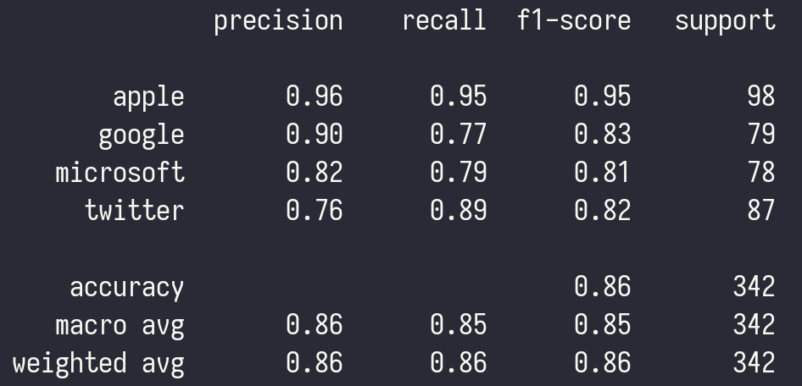
Results of company classifier

Slide 6
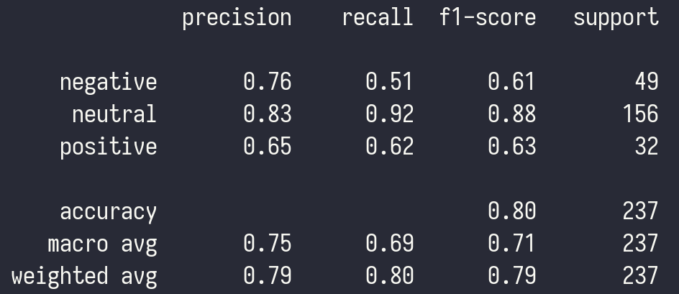
Results of sentiment classifier

Slide 7
Thanks!

